Slide 1
Matrix Arithmetic
C Programming Individual Project, Year 1, Semester 1
Dulapah Vibulsanti (64011388)
Notes:
Greetings, and welcome to my C programming individual project presentation. I’m Dulapah Vibulsanti and I’m proud to present you my program called Matrix Arithmetic. Let’s see what it can do. Oh and don’t worry, I will have a demo of my program for you!

Slide 2
Matrix Arithmetic
C Programming Individual Project, Year 1, Semester 1
Dulapah Vibulsanti (64011388)

Slide 3
1. Project Description
Notes:
So, first, let’s talk about project description

Slide 4
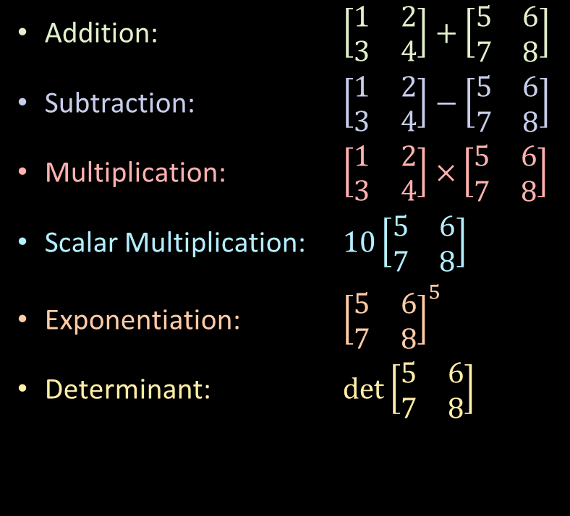

Matrix Arithmetic
A feature-packed matrix computing program that runs in the terminal
Addition: $\left[\begin{matrix}1 & 2 \\ 3 & 4\end{matrix}\right]+$ $\left[\begin{matrix}5 & 6 \\ 7 & 8\end{matrix}\right]$
Subtraction: $\left[\begin{matrix}1 & 2 \\ 3 & 4\end{matrix}\right]−$ $\left[\begin{matrix}5 & 6 \\ 7 & 8\end{matrix}\right]$
Multiplication: $\left[\begin{matrix}1 & 2 \\ 3 & 4\end{matrix}\right]×$ $\left[\begin{matrix}5 & 6 \\ 7 & 8\end{matrix}\right]$
Scalar Multiplication: $10\left[\begin{matrix}5 & 6 \\ 7 & 8\end{matrix}\right]$
Exponentiation: ${\left[\begin{matrix}5 & 6 \\ 7 & 8\end{matrix}\right]}^{5}$
Determinant: $det\left[\begin{matrix}5 & 6 \\ 7 & 8\end{matrix}\right]$
Transposition: ${\left[\begin{matrix}5 & 6 \\ 7 & 8\end{matrix}\right]}^{T}$
Inverse: ${\left[\begin{matrix}5 & 6 \\ 7 & 8\end{matrix}\right]}^{−1}$
Adjoint: $adj\left[\begin{matrix}5 & 6 \\ 7 & 8\end{matrix}\right]$
Notes:
This project aims to create a matrix computing program that runs in the terminal. So here are the key features, you can see that there are a lot of features in this program. And also, the program will also detect matrix compatibility when performing certain operations. For example, adding/subtracting/multiplying matrix with different dimensions will give out error. Finding the inverse of a matrix with det = 0 will give out an error, and much more.

Slide 5
Language and Library used
The program is written in C language
Library used are:
<stdio.h>
<stdlib.h>
<string.h>
<math.h>
Notes:
My program is written in pure C language and the library I used are stdio.h, stdlib.h, String.h just for reading from a file and math.h just for exponentiation.

Slide 6
Plan
1. Design UI
2. Plan what arithmetic to include
3. Plan how the input/output will look like
Notes:
So my first plan is designing the user interface so that it is easy to use and also make user experience good. Next I plan what arithmetic to include and after that plan how the input/output will look like.
The answer is automatically output in the output.txt file with proper matrix brackets and also generates LaTeX code for the user. The program also outputs answers in the output.csv file as a comma-separated value.
We will take a look at that later on

Slide 7
How do you plan out your work?
1. Design UI
2. Plan what arithmetic to include
3. Plan how the input/output will look like

Slide 8
2. Source Code Explanation
Notes:
Next, let’s talk about source code explanation

Slide 9
Flowchart
Notes:
So this is the flowchart of my program. Let me zoom into each part so you can see more clearly of what is going on

Slide 10
Notes:
So you can see that, after launching the program, the program will prompt user 4 options. Define matrix, view matrix, compute matrix, and exit.
Define matrix is where user can create a matrix before they will be used to compute. View matrix is where user can view their defined matrix. Compute matrix is where user can perform arithmetic on matrix. And finally exit, as the name suggests, is where user exit the program.

Slide 11
Notes:
Firstly, we will take a look at define matrix. After selecting, the program will prompt user whether to input through terminal or file.

Slide 12
Notes:
If user choose to input through the terminal, the program will prompt user for rows, columns and values. But if user choose file, the program will prompt user for delimiter.

Slide 13
Notes:
After entering the delimiter, the program will now check whether the file is empty or not. If the file is empty then the program will display an error. If not, then the program will display the read value of matrix from a file and automatically store them into the selected matrix.

Slide 14
Notes:
And after that, the program will go back to define matrix page so that user can choose whether to define more matrix or not

Slide 15
Notes:
Now we will take a look at view matrix. After user selected view matrix, the program will prompt user to select a matrix. After user select the matrix, a stored matrix value will appear.

Slide 16
Notes:
Next is compute matrix page. Here, user can select the operation that they want to perform. There are addition, subtraction, multiplication, scalar multiplication, exponentiation, determinant, transposition, inverse, and adjoint.

Slide 17
Notes:
After that the program will check whether the selected matrix is compatible with the selected operation or not, for example, matrix dimensions and adding or subtracting matrix together. After that, the program will store the answer in matrix answer so that user can use it to perform further calculations later on.

Slide 18
Notes:
Now the program will go back to compute matrix page and prompt user whether they want to do more operations or not.

Slide 19
Notes:
Finally, if user select exit, the program will free the pointer and finally exit the program.

Slide 20
What I learn in class for this project
Flow of control (If-else, switch, loops, while loops, etc.)
Functions
Pointers and Arrays
Structure
Recursion
Dynamic Memory Allocation
Reading from and writing to a file
Notes:
So this is what I’ve learned from the class. They are flow of control, defining functions, using pointers and arrays, using structure, incorporating recursion, allocating memory dynamically using malloc, and finally reading from and writing to a file

Slide 21
What I learn in class for this project
Flow of control (If-else, switch, loops, while loops, etc.)
Functions
Pointers and Arrays
Structure
Recursion
Dynamic Memory Allocation
Reading from and writing to a file

Slide 22
3. Project Demonstration
Notes:
And now, let’s see my project in action!

Slide 23
4. Future
Notes:
And the last part is about how my project can be improved

Slide 24
How this project can be improved?
Change the use of double ***matrixAns, int *rowAns, int *columnAns to struct pointer instead. It could be refactored into something like struct Matrix *matAns. Then access the struct variables using the arrow operator like matAns->rowAns
Notes:
So here, I can utilize struct pointer and arrow operator to make my code more readable

Slide 25
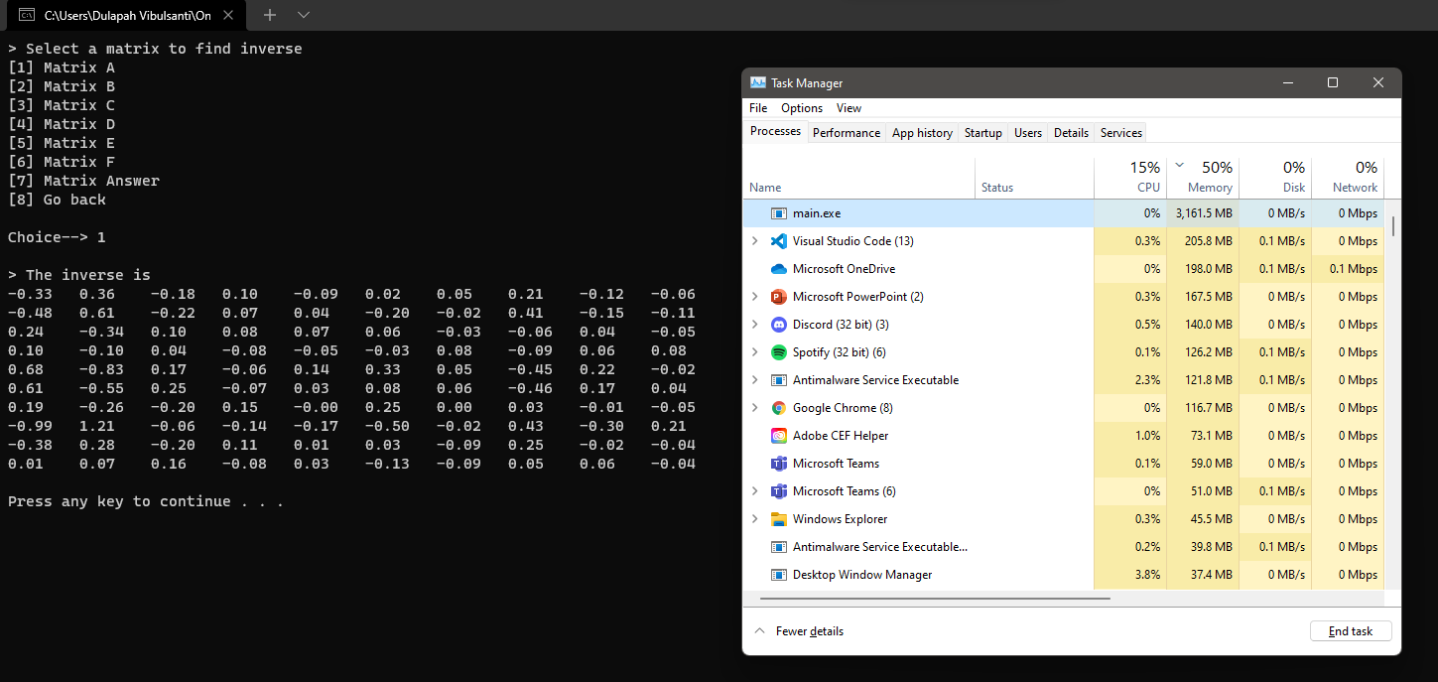
How this project can be improved?
Performing arithmetic (notably determinant, inverse, and adjoint) on a very large matrix can result in excessive memory consumption.
Notes:
And also, currently, my project will consume a lot of memory if the matrix size is very big

Slide 26
Matrix Arithmetic
C Programming Individual Project, Year 1, Semester 1
Dulapah Vibulsanti (64011388)
Notes:
And this has been my presentation on Matrix Arithmetic. Thank you for your attention and thank you for your time.

